Slide 1
TITLE
MITIGATING EAVESDROPPING IN WEB CONFERENCING AND DOCUMENT COLLABORATION SYSTEM
                By:
                DANIEL MAINA GUTHUA
                SCT221-C004-0403/2022

Slide 2
CHAPTER ONE: INTRODUCTION
Background
Commercial tools like Zoom and Teams face security vulnerabilities (e.g., MITM attacks, data breaches).
Rising SaaS costs strain budgets (Gartner, 2022).
Proposed system integrates secure teleconferencing and real-time document collaboration.
Emphasizes end-to-end encryption, role-based access control, and ISO/IEC 27001(2002) compliance.
Inspired by Forrester’s research (2023) on secure collaboration guidelines.

Slide 3

CHAPTER ONE: INTRODUCTION CONT…
Problem Statement
Eavesdropping remains a major threat despite Transport Layer Security and Multi-Factor Authorization.
34% of organizations reported unauthorized access (Ponemon, 2021).
Attackers exploit unencrypted data, insecure APIs, and misconfigured access controls. eg How President Uhurus Council of Governors zoom meeting was interrupted by a hacker
Need for a multi-layered security framework balancing usability, performance, and protection.

Slide 4
CHAPTER ONE: INTRODUCTION CONT…
  Project Objectives
  Identify vulnerabilities which can be exploited for eavesdropping.
  Evaluate existing security measures designed to mitigate eavesdropping .
  Implement multi-layered security framework.
  Test and evaluate effectiveness and reliability of proposed security framework.
  Provide user/admin security recommendations.

Slide 5
CHAPTER ONE: INTRODUCTION CONT…
  Project Justification
  Prevent unauthorized access using encryption.
  Monitor/block suspicious activity in real time.
  Ensure seamless collaboration without performance lag.
  Reduce breaches by educating users
  Project Scope and Limitations
  Target users: organizations, institutions, remote teams.
  Focus: software vulnerabilities, not hardware flaws.
  Limitations: user compliance, data availability, proprietary systems

Slide 6
CHAPTER ONE: INTRODUCTION CONT…
  Project Budget Summary
  Total Budget: Kshs 153,000.00
    Hardware: Kshs 60,000.00
    VM & Domain: Kshs 20,000.00
    Elicitation: Kshs 28,000.00
    Documentation: Kshs 3,000.00
    Miscellaneous: Kshs 42,000.00
    Project schedule

Slide 7
CHAPTER TWO: LITERATURE REVIEW
Historical Development:
  1964: First video conferencing at World’s Fair (Joskowicz, 2023)
  1990s–2000s: Rise of WebEx, Skype, and iChat (Tang et al., 2022).
  COVID-19: Accelerated adoption of platforms like Zoom and Teams (Karl et al., 2021)
Security Concerns: Increased usage led to higher risks of eavesdropping and data breaches.

Slide 8
CHAPTER TWO: LITERATURE REVIEW CONT…
Key Functions & Capabilities
Core Functions:
  Real-time video/audio communication.
  Document sharing and editing.
  Messaging and file exchange.
Benefits:
  Enhances remote collaboration.
  Boosts productivity and decision-making.

Slide 9
CHAPTER TWO: LITERATURE REVIEW CONT…
System Elements & Architecture
Key Components:
  WebRTC for real-time communication.
  Role-Based Access Control (RBAC), MFA, and SSO.
  End-to-end encryption and TLS.
Proposed Architecture:
  Secure SIP session encryption.
  Dynamic DNS updates for seamless connectivity.
  Cost-effective alternative to SaaS models.

Slide 10
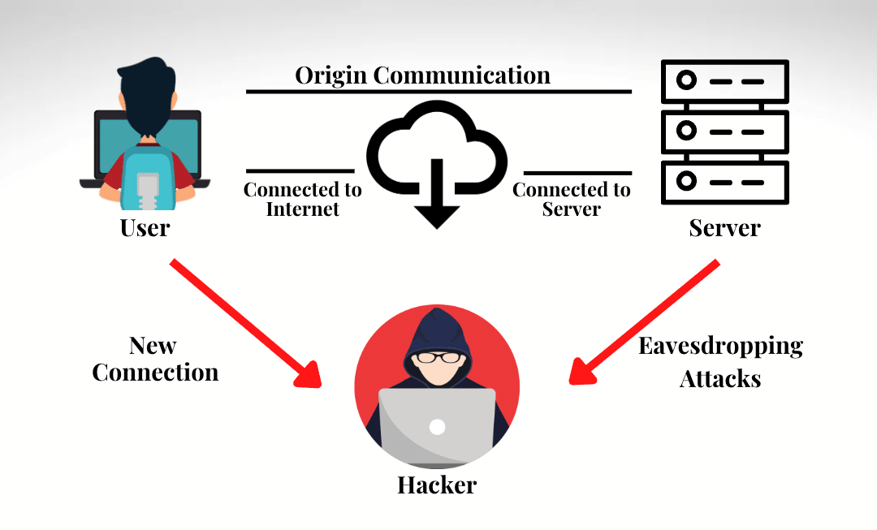
CHAPTER TWO: LITERATURE REVIEW CONT…

Slide 11
CHAPTER TWO: LITERATURE REVIEW CONT…
Trends, Challenges & Recommendations
Future Trends:
  AI for workflow automation and analytics (Court, 2024).
  AR/VR for immersive collaboration (Joskowicz, 2023; Mahboubi et al., 2024).
  Enhanced cybersecurity protocols (Court, 2024).
Acquisition Challenges:
  High costs, limited customization, security gaps.
  Open-source tools recommended for flexibility and cost-efficiency.

Slide 12
CHAPTER TWO: LITERATURE REVIEW CONT…
Standards & Compliance
Security Standards:
  ISO/IEC 27001:2022 for information security management.
Benefits:
  Ensures confidentiality, integrity, and availability.
  Builds user trust and regulatory compliance.
Conclusion:
  Secure, integrated platforms are essential for modern, remote collaboration.

Slide 13
CHAPTER THREE: RESEARCH METHODOLOGY
Introduction & Research Design
Purpose: To outline the methodology for designing a secure web teleconferencing and real-time document collaboration system.
Research Design:
  Quasi-experimental approach.
  Tests the system in a real-world environment..
  Ensures structured development and minimizes resource waste.

Slide 14
CHAPTER THREE: RESEARCH METHODOLOGY CONT…
Research Method
Mixed-Methods Approach:
  Quantitative: Structured data collection for generalizable results.
  Qualitative: In-depth understanding of phenomena.
Four Phases:
  Identify vulnerabilities in existing platforms.
  Define security, functional and non-functional requirements of the system.
  Develop the system.
  Assess security, usability, and cost-effectiveness.
Notes:
Four Phase Journey: From Theory to Practice
Key Point: Outlines the four key phases of the research:
Vulnerability Identification
Requirement Definition
System Development
System Assessment

Slide 15
CHAPTER THREE: RESEARCH METHODOLOGY CONT…
Data Collection
Primary Sources:
  Observation: Real-time user interaction.
  In-depth Interviews: Unstructured, emotional insights. Offer flexibility, Levy and Ellis (2011)
  Questionnaires: Both structured and unstructured formats.
Secondary Sources:
  Review of existing literature and security reports on competing platforms
Notes:
Observation is all about gathering and analyzing real time data while interacting with a sample group of users so as to understand and meet the system requirement.
Interviews are personal and unstructured discussions aimed at identifying participant’s emotions, feelings, and opinions regarding a specific research subject.
Questionnaires can either be structured to allow specific types of responses such as yes, no and likely scales or unstructured questions to enable the respondents to give responses as they wish

Slide 16
CHAPTER THREE: RESEARCH METHODOLOGY CONT…
Target Population, Reliability & Validity
  Target: Corporate organizations in Nairobi using collaboration tools.
  Sampling: Purposive sampling of 30 organizations.
  Reliability: Test-retest method; pilot study with 10% of sample.
  Validity: Supervisor-reviewed instruments to ensure accuracy.
Notes:
A non-probabilistic sampling technique; to be precise a purposive/judgemental sampling will be adopted to select a group of respondents that know, relates, or are proficient with the research subject. Purposive sampling will ensure that a particular subset of individuals is selected because they will fit a particular profile. However, due to time and resources limitation, the study will focus on 30 organizations, randomly selecting the respondents in those organizations.

Slide 17
CHAPTER THREE: RESEARCH METHODOLOGY CONT…
Data Analysis & Ethics
Analysis: Thematic analysis of interviews, observations, and questionnaires.
Ethical Considerations:
  Informed consent.
  Confidentiality and voluntary participation.
  Approval from JKUAT IT Department.
  Objectivity and data integrity maintained.

Slide 18
CHAPTER FOUR: SYSTEM ANALYSIS
Collecting and interpreting facts, identifying problems, decomposing a system into components (Chiang, 2009)
Existing solutions
  Zoom - Zoombombing, weak encryption
  Microsoft Teams- complex, costly
  WebEx – costly, complex to manage
  Google Meet – lacks advanced security
  Gap Identified: Existing platforms are costly, lack comprehensive security, data protection, and seamless collaboration

Slide 19
CHAPTER FOUR: SYSTEM ANALYSIS CONT…
Proposed System: Wasihi Web Teleconferencing & Real-time Document Collaboration System
Features: Real-time document editing & sharing, Built-in audio/video conferencing, Advanced encryption, Calendar, task management
  Requirements:
  Functional: User registration & authentication, real-time collaboration, encryption, audio/video communication, screen sharing
  Non-Functional: Usability, performance, reliability, scalability.
  Feasibility
  Economic: Minimal costs after setup (open-source software).
  Technical: Works with standard hardware & Linux/MariaDB/MySQL.
  Legal: Compliant with DPA 2019 & CMCA 2018.

Slide 20
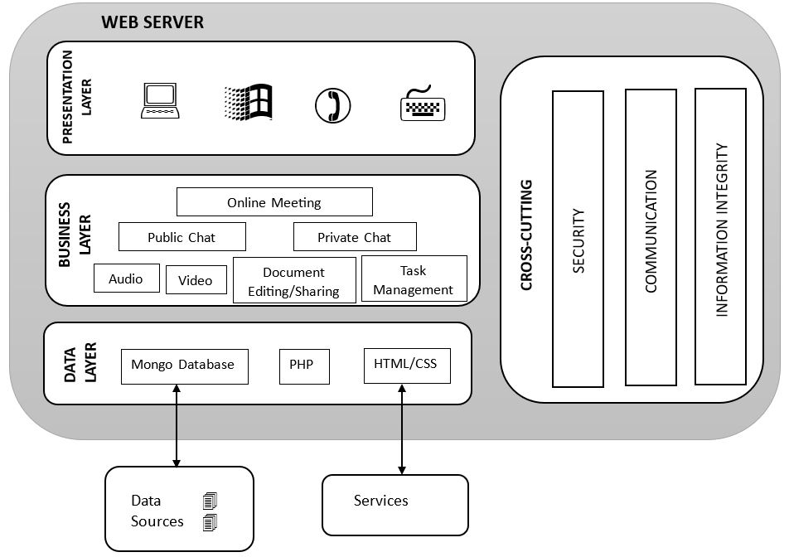
CHAPTER FIVE: SYSTEM DESIGN
  Software Architecture of Wasihi
Notes:
The software architecture of this web application represents its logical implementation and deployment processes. It consists of a multi-layered design, including three main layers under the server-side logic and a separate layer for cross-cutting concerns.
Presentation Layer: Manages the user interface and interactions using HTML, CSS, and JavaScript, accessible via devices like PCs, tablets, and smartphones.
Business Layer: Handles core application logic, processes requests, and interacts with the data layer, implemented in languages such as Java, PHP, or Node.js.
Data Layer: Manages data storage and retrieval, abstracting database operations. This system uses MongoDB (NoSQL).
Cross-Cutting Concerns: Provides centralized functions like authentication, authorization, caching, logging, exception handling, and validation across all layers

Slide 21
CHAPTER FIVE: SYSTEM DESIGN CONT…
  Wasihi System Overview
    Wasihi is a platform for web teleconferencing, real-time document editing and collaboration.
    It will require the bare minimum data (username and a password) before enabling communication and sharing of information.
    Wasihi will have the following modules: document sharing, document editing, audio/video chat, file access control, multi-layer encryption, and task management.
    General overview of the system

Slide 22
CHAPTER FIVE: SYSTEM DESIGN CONT…
  Unified Modeling Language
    Way of visualizing a software program using a collection of diagrams
    Three types of UMLs used
      Use Case Diagram
      Sequence Diagram
      Activity Diagram

Slide 23
CHAPTER FIVE: SYSTEM DESIGN CONT…
  Use-case diagrams of the system and the subsystems:
    Wasihi System
    Registration Subsystem
    Administration Subsystem
    Interaction Subsystem
Notes:
Use case diagrams were used to understand the core functionalities and usage scenarios.
Components:
Actors: Actors represent the external entities, such as people or other systems, that interact with the system being modeled.
Use Cases: Use cases represent the functional capabilities of the system from the user's perspective.
Associations: Associations are the connections drawn between actors and use cases, indicating which actors interact with which use cases.
System Boundary: The system boundary defines the scope of the system being modeled, enclosing the use cases that are part of the system.

Slide 24
CHAPTER FIVE: SYSTEM DESIGN CONT…
  Sequence Diagram
    Displays participants horizontally & interactions vertically revealing how different system elements exchange messages, execute operations, and collaborate
    Four elements include:
      Objects
      Lifelines
      Messages
      Focus of control
    Sequence Diagram for the Wasihi System
Notes:
Objects: Positioned horizontally across the top of the diagram, representing the key actors or system components involved in a specific process.
Lifelines: Dashed lines that track the object's existence and involvement throughout the interaction timeline. These lifelines serve as a visual representation of an object's lifespan and participation in the system's workflow.
Messages: Illustrate the communication and method calls between different objects. The arrows are carefully labeled to describe the specific nature of the interaction, whether synchronous (waiting for a response) or asynchronous (non-blocking).
Focus of control: Narrow rectangular boxes positioned along the lifelines. They indicate when an object is actively processing or executing a specific method, highlighting the periods of active engagement for each system component.

Slide 25
CHAPTER FIVE: SYSTEM DESIGN CONT…
  Activity Diagram
    Provides a graphical representation of the actions, decision points, and interactions involved in the web teleconferencing, real-time document editing and collaboration
    Activity Diagram for Wasihi System
Notes:
The activity diagram illustrates the sequential workflow and process flow for users within the system

Slide 26
CHAPTER FIVE: SYSTEM DESIGN CONT…
    Diagram Zero

Slide 27
CHAPTER FIVE: SYSTEM DESIGN CONT…
  Database Design
    Serves as a critical technological infrastructure that enables organized data management across various domains and applications (Chiang, 2009)
    Designing a database produces:
      Conceptual models - Focuses on identifying entities, their attributes and relationships. Entity Relationship Diagram for Wasihi System
      Physical models
      Logical models - specifies the tables, columns, data types, and relationships. Wasihi Logical Models
Notes:
A database represents a structured digital repository designed to efficiently store, manage, and retrieve information systematically

Slide 28
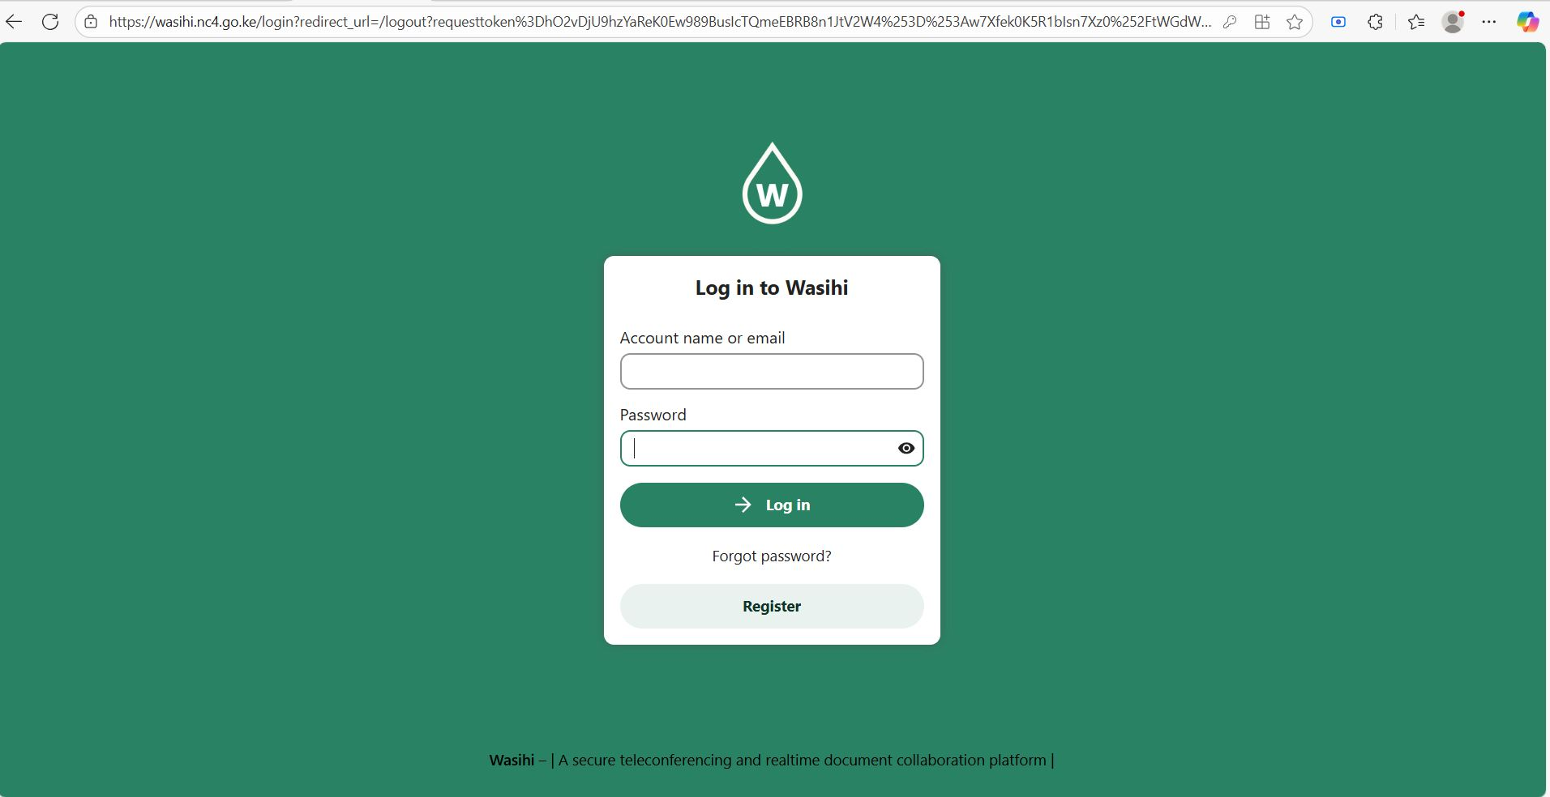
CHAPTER TWO: LITERATURE REVIEW

Slide 29
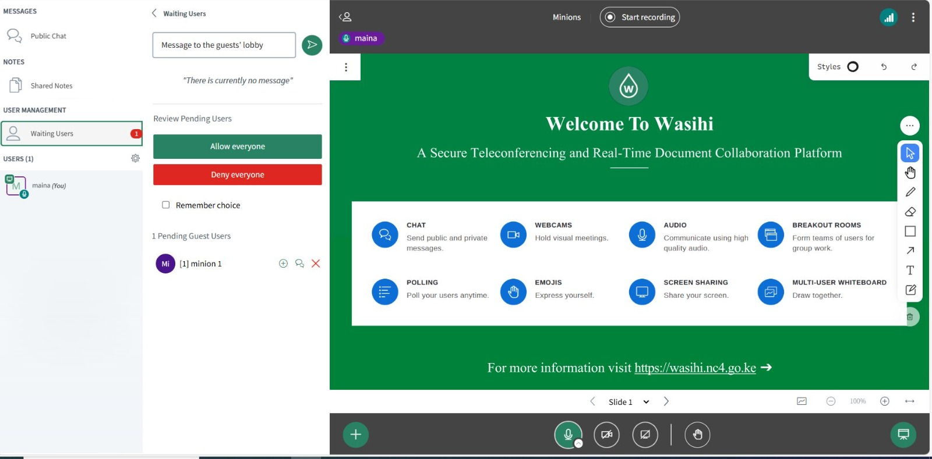
CHAPTER TWO: LITERATURE REVIEW

Slide 30
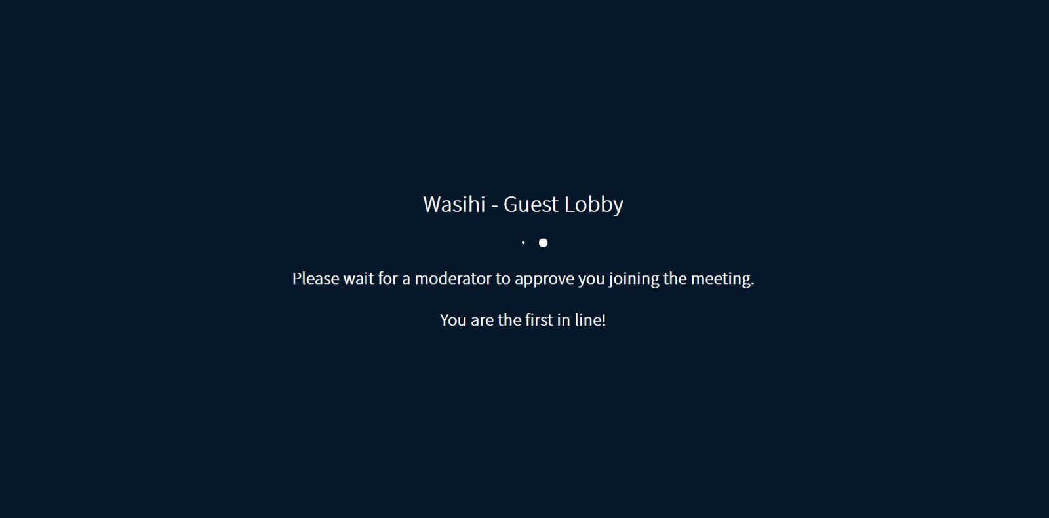
CHAPTER TWO: LITERATURE REVIEW

Slide 31
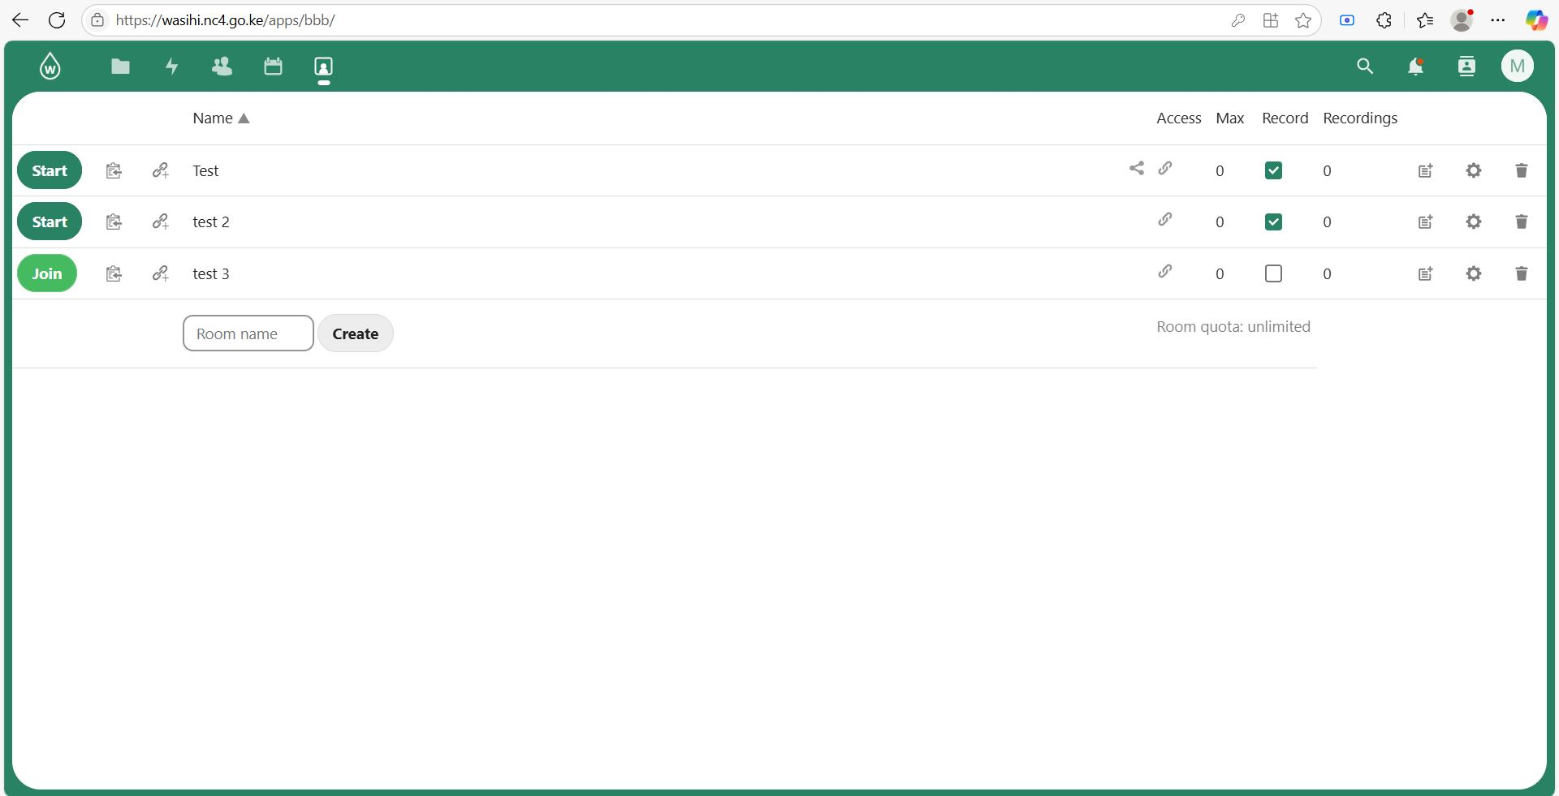
CHAPTER TWO: LITERATURE REVIEW

Slide 32
CHAPTER TWO: LITERATURE REVIEW
Conclusion
Wasihi addresses security & accessibility challenges.
Offers cost-effective, user-friendly, and secure collaboration.
Supports remote/hybrid work needs, empowering distributed teams.
Recommendations
Integrate AI features (transcription, sentiment analysis, automation).
Explore AR/VR for richer collaboration.
Develop multi-tenant & scalable architecture.
Conduct broader testing in varied organizational contexts.

